Slide 1
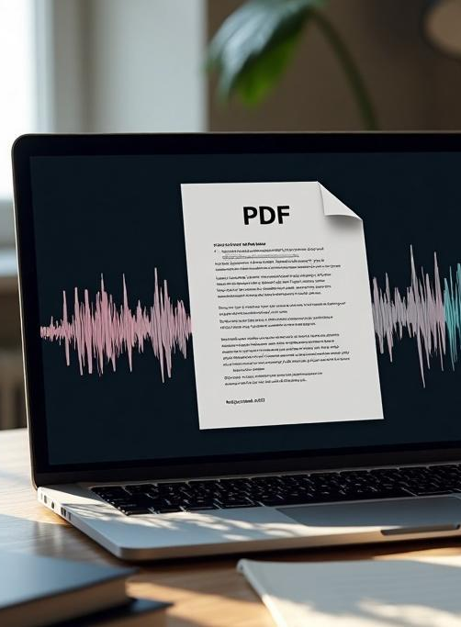
Converting PDF to Audio
A Comprehensive Guide Using Python Libraries: PDF Reader, gTTS, and PyDub.

Slide 2
Introduction
This presentation explores the process of converting PDF documents into audio format using popular Python libraries. We will cover the PDF Reader library for extracting text, gTTS for converting text to speech, and PyDub for audio processing.

Slide 3

01
PDF Reader

Slide 4
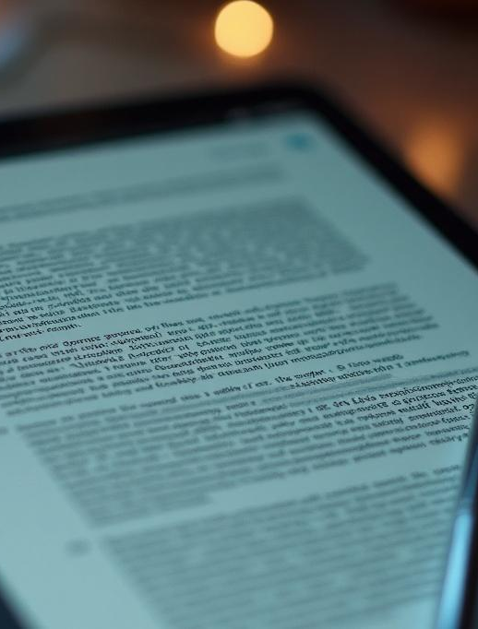
Overview of PDF Reader Library
The PDF Reader library in Python allows users to extract text information from PDF documents effortlessly. It supports a variety of PDF formats and offers functionalities that help in accessing text by pages or whole documents.

Slide 5
Installation and Setup
To install the PDF Reader library, you can use pip: `pip install PyPDF2`. After installation, you need to import the library into your Python script to begin reading PDF files.

Slide 6
Basic Usage and Features
Open the application by running the Python script.
Select PDF File:
Click the "Browse" button next to "Select PDF File" and choose a .pdf file.
Select Output Location:
Click the "Browse" button next to "Select Output Location" to choose where the audio file will be saved.
Convert to Audio:
Click the "Convert to Audio" button.
The app extracts text from the PDF and converts it into an .mp3 audio file using Google Text-to-Speech (gTTS).
Listen to the Audio:
Once done, a message shows where the audio file is saved. Open it with any media player.

Slide 7
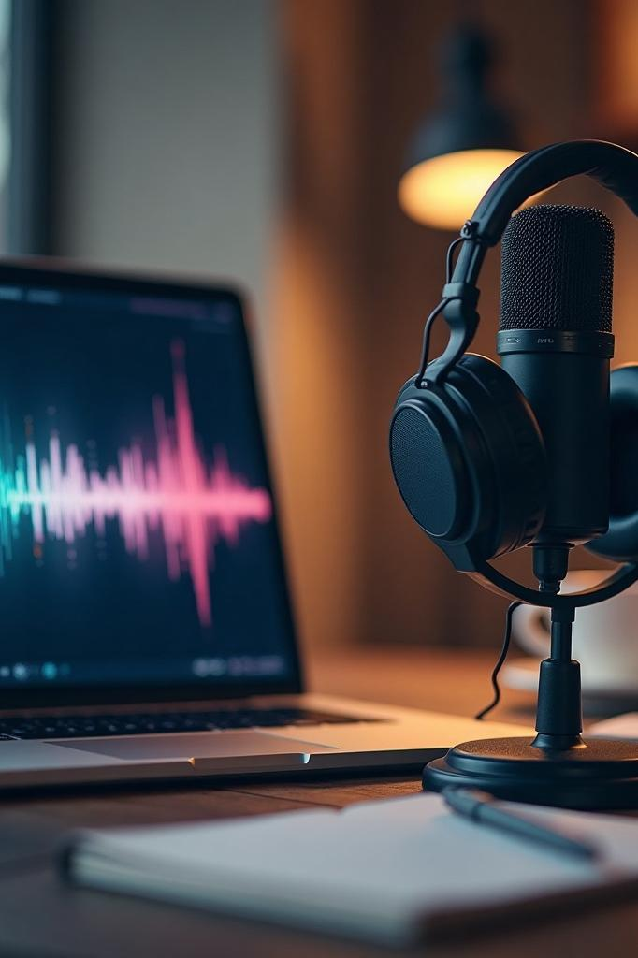
02
Text-to-Speech Conversion

Slide 8
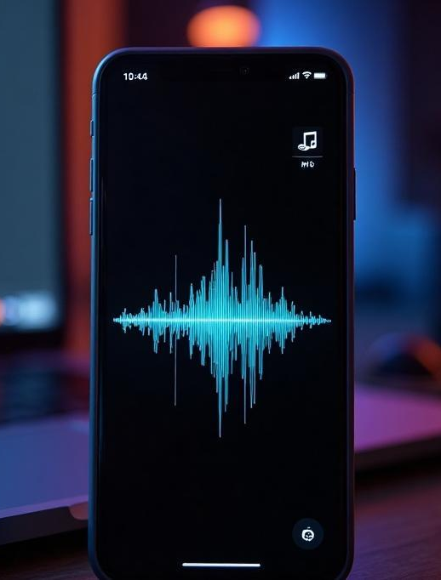
Introduction to gTTS
The gTTS (Google Text-to-Speech) library enables the conversion of text to speech using Google's TTS API. It supports multiple languages and allows users to generate speech files in MP3 format quickly.

Slide 9
Integrating gTTS with PDF Reader
To integrate gTTS with PDF Reader, extract the text from the PDF using the PDF Reader library. Once the text is available, feed it into the gTTS library to generate audio output.

Slide 10
Saving Audio Files
After generating the audio using gTTS, save the audio content to an MP3 file. This is typically done using the `save` method, allowing for easy playback and distribution.

Slide 11
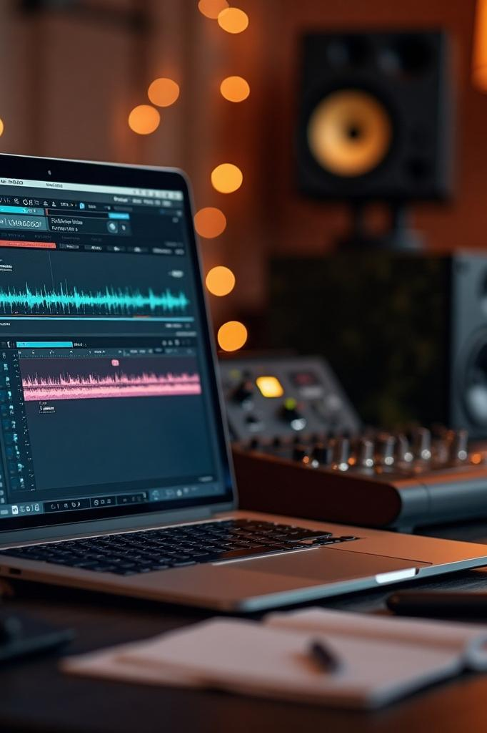
03
Audio Processing

Slide 12
Using PyDub for Audio Manipulation
PyDub is a Python library that simplifies audio manipulation tasks. It allows you to load audio files, adjust parameters like volume, trim sections, and more.

Slide 13

Editing and Enhancements
With PyDub, you can edit audio by applying effects, such as fading in and out, converting audio formats, and manipulating the speed of playback for finer audio adjustments.

Slide 14
Exporting Final Audio Formats
Once editing is complete, use PyDub to export the final audio in the desired format, such as MP3 or WAV. This ensures compatibility with various playback systems.

Slide 15
Conclusions
In summary, the process of converting PDF to audio in Python involves extracting text with PDF Reader, converting it to speech using gTTS, and manipulating audio with PyDub. This workflow allows for creating accessible audio content from written documents.

Slide 16
Thank you!
Do you have any questions?
Please keep this slide for attribution

